Slide 1
Adaptive Exam Preparation & Performance Analyzer
By Aryan Patel &
Sakshi Pandya

Slide 2
Problem and Approch
Study material is scattered across PDFs, scanned question banks, and handwritten notes
Generic quizzes ignore each student’s actual proficiency and readiness
Upload any material into isolated per-user workspace
Extract topics automatically with local OCR = NPL (no third party AI APIs
Track progress with an ML-driven exam-readiness score

Slide 3
Built on a modern &
Self-hosted stack
Backend
Django 5.2 + DRF, JWT auth, standardized JSON responses
Frontend
React + Vite, connecting to backend via API
OCR/ NLP/ ML
EasyOCR, OpenCV, Camelot and a Gradient Boosting readiness model
Infrastructure
PostgreSQL, MinIO (S3-complatible), Ollama LLM— all via Docker Compose

Slide 4
How it works
Upload
Upload any study material that you have
Extract
System pulls out topics and questions for the quizzes
Assess
Take a quiz built from the data you submitted
Track
track you progress and prepare for the exams

Slide 5
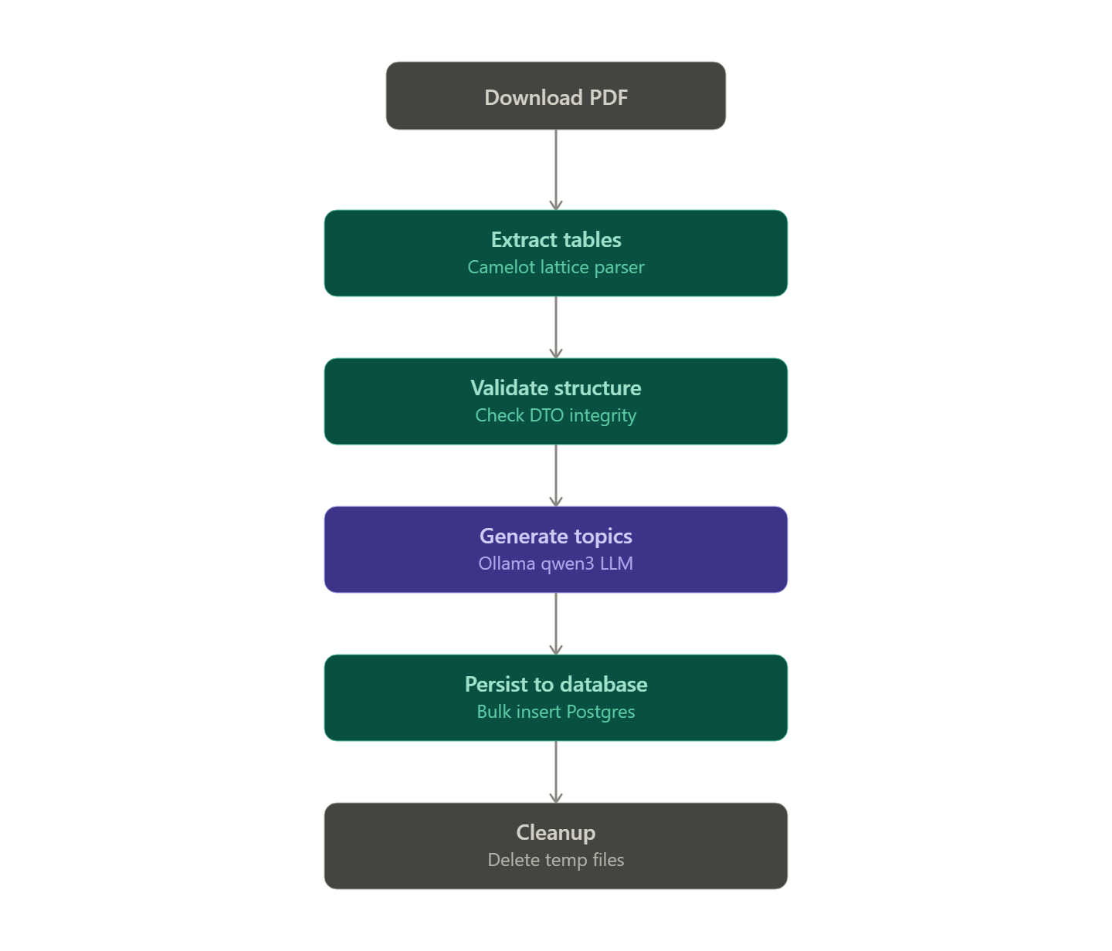
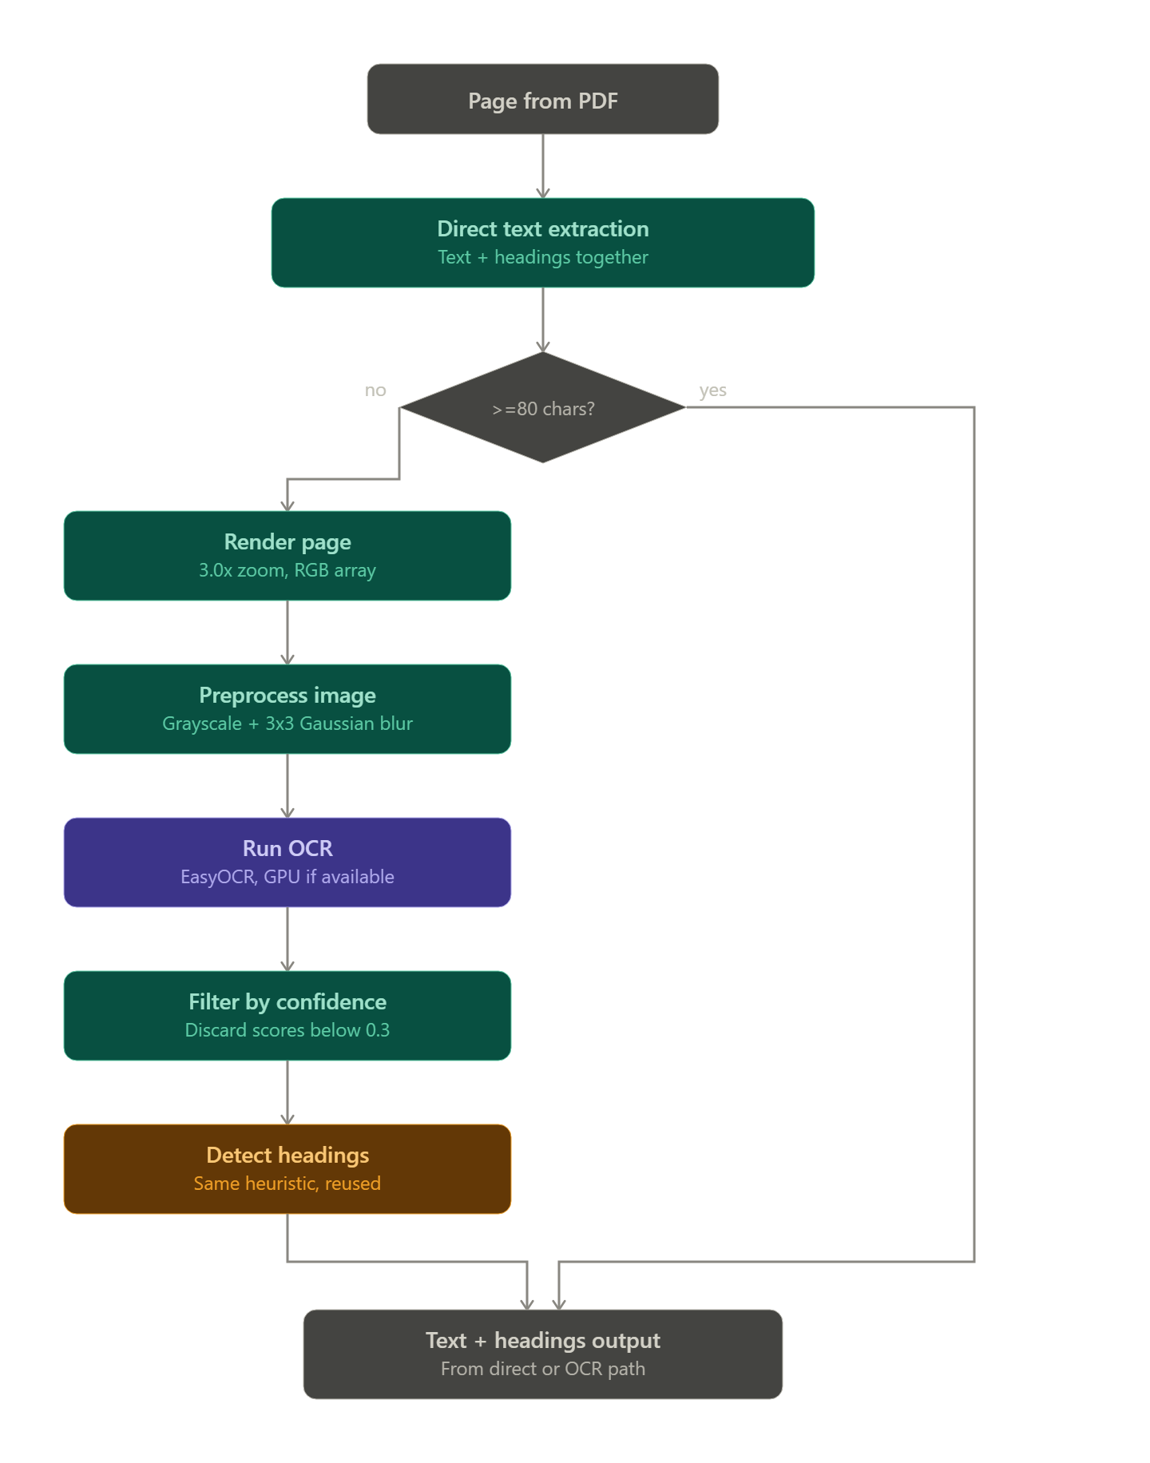
Question Bank Extraction Pipeline Notes Extraction Pipeline

Slide 6
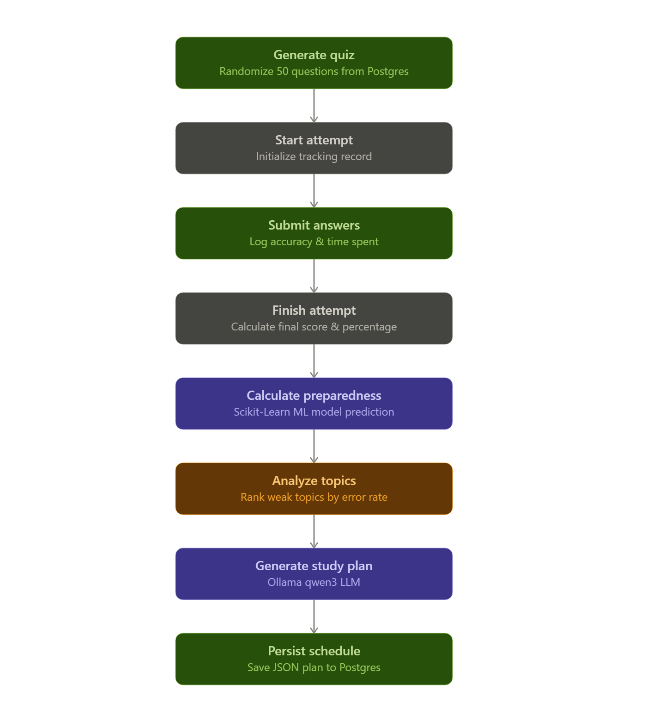
Quiz and Schedule Generation Pipeline

Slide 7
Future Scope
Improve handwritten text recognition and extend support for additional document formats such as Jupyter Notebook (.ipynb) files.
Enhance NLP-based topic extraction, topic classification, and question-to-topic mapping to identify topics more accurately from different study materials.
Develop more advanced adaptive quizzes that dynamically adjust question difficulty and topic selection based on the student's previous accuracy, response time, and weak areas.
Implement continuously personalized study plans that automatically update after each quiz based on the student's latest performance, weak topics, and learning progress.

Slide 8
Thank you

